Slide 1
Structured Intelligence - A Comprehensive Survey of Foundation Models and Research Outlook
SOUMYA BHARATHI VETUKURI
016668964

Slide 2

My Presentation is based on the following research paper:
A Survey of Time Series Foundation Models: Generalizing Time Series Representation with Large Language Model
By : JIEXIA YE, WEIQI ZHANG, KE YI, YONGZI YU, ZIYUE LI, JIA LI, FUGEE TSUNG
Research Paper Link: https://arxiv.org/pdf/2405.02358
Medium Article: https://medium.com/p/3d85ce6469b7/edit
Other References:
https://github.com/start2020/Awesome-TimeSeries-LLM-FM

Slide 3
AGENDA OVERVIEW
What are Foundation Models?
3E Framework & Research
Time Series Tasks
Pre Training Foundation Models
Adaptation Paradigms
Roles of LLMs in Time Series
Improving Model Efficiency
Making Models Explainable
Foundation Models Across Domains
Libraries, Datasets, Tools
Limitations and Research Gap
Conclusion

Slide 4
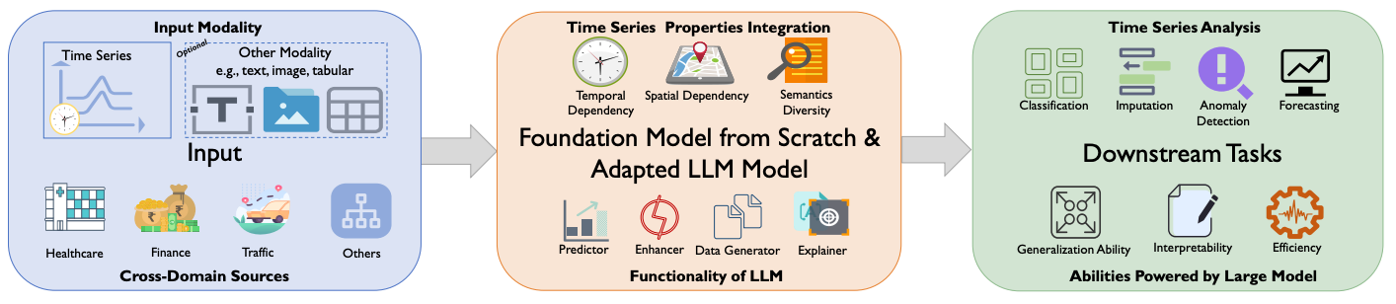
“Time waits for no one - except maybe foundation models”
Time series is everywhere: ECGs, stocks, sensors.
Challenge: Extracting generalizable insights from it.
Can foundation models match their success in NLP & vision?

Slide 5
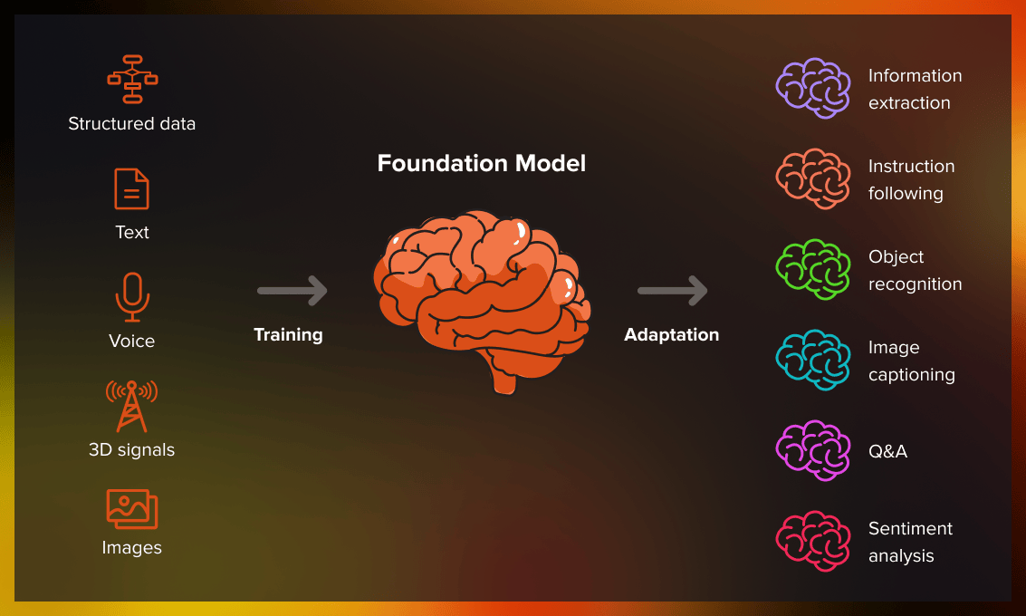
What Are Foundation Models?
Pretrain on massive data → fine-tune on tasks.
Enable generalization, few-shot learning and zero-shot reasoning.
Examples: GPT (text), CLIP (vision), DALL·E (multimodal).
Have transformed fields like natural language processing and computer vision.

Slide 6
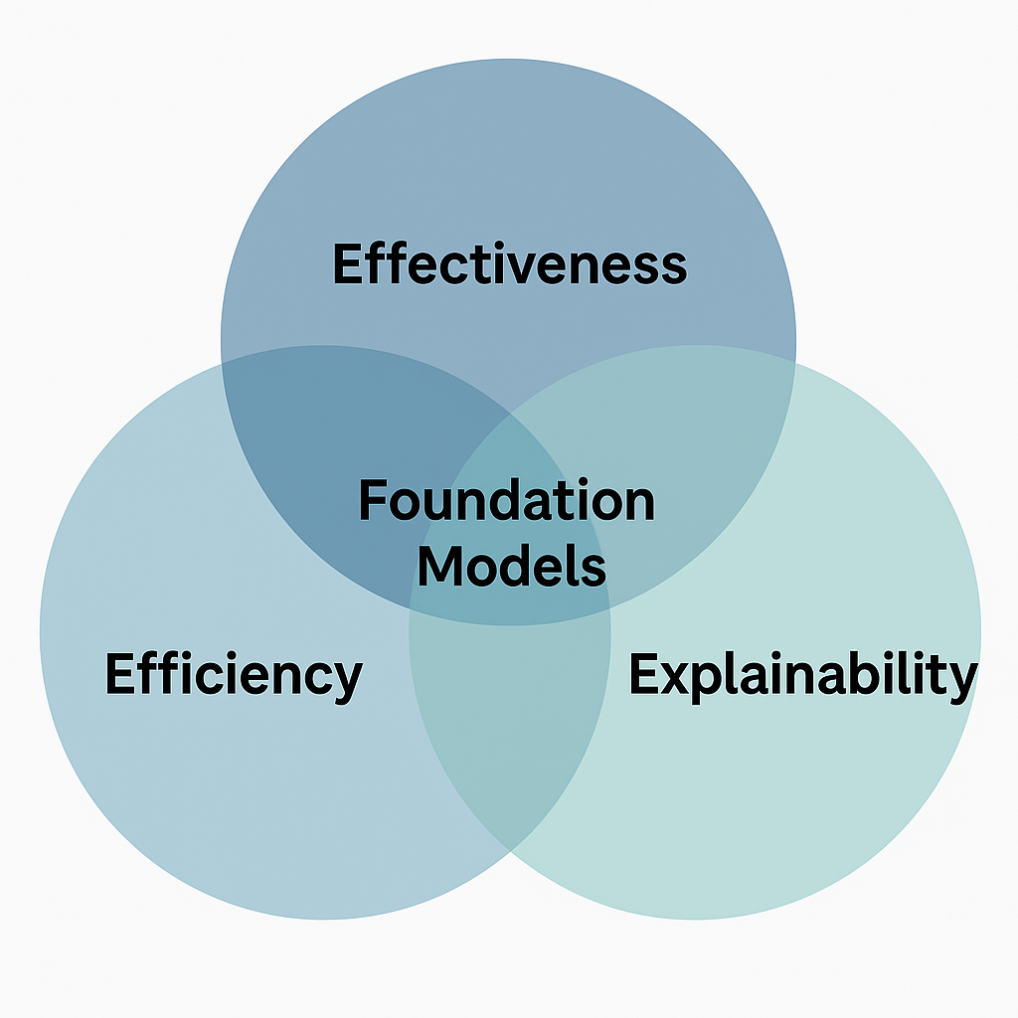
3E Framework & Research Questions
Framework:
Effectiveness: Task performance.
Efficiency: Computational cost.
Explainability: Transparency of decisions.
Research Questions:
Adapting foundation models effectively for time series.
Efficient pretraining and fine-tuning methods.
Enhancing explainability.
Applications across domains.

Slide 7
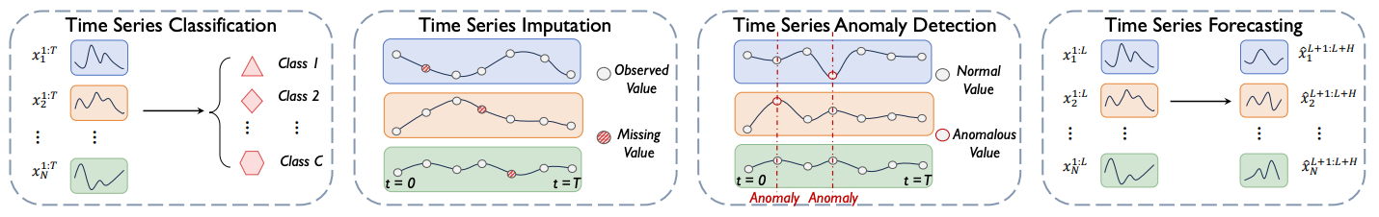
Foundation Models and Time Series Tasks
Pretrain–then-finetune approach:
Pretrained on large datasets → adapted to specific tasks
Popular in NLP and vision (e.g., GPT, CLIP, DALL·E)
Now extended to time series data
Time Series Tasks:
Classification
Forecasting
Imputation
Anomaly Detection
Unique Modeling Properties:
Temporal Dependency
Spatial Dependency
Semantic Diversity

Slide 8
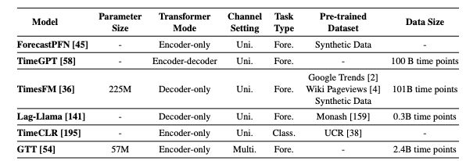
Pre-training Foundation Models
Approaches:
Pre Training from scratch ( Time GPT, TimesFM)
Adapting LLMs via fine-tuning or prompting
Goal: general-purpose, interpretable, multimodal models
Both are complementary, not competing
Techniques & Models:
Models: Time GPT, TimesFM, GTT, Lag-Llama
Data Techniques: Jittering, patching, synthetic generation
Architectures: Encoder-only, Decoder-only, Encoder-decoder
Observed diversity in architectures and how they build temporal understanding.

Slide 9
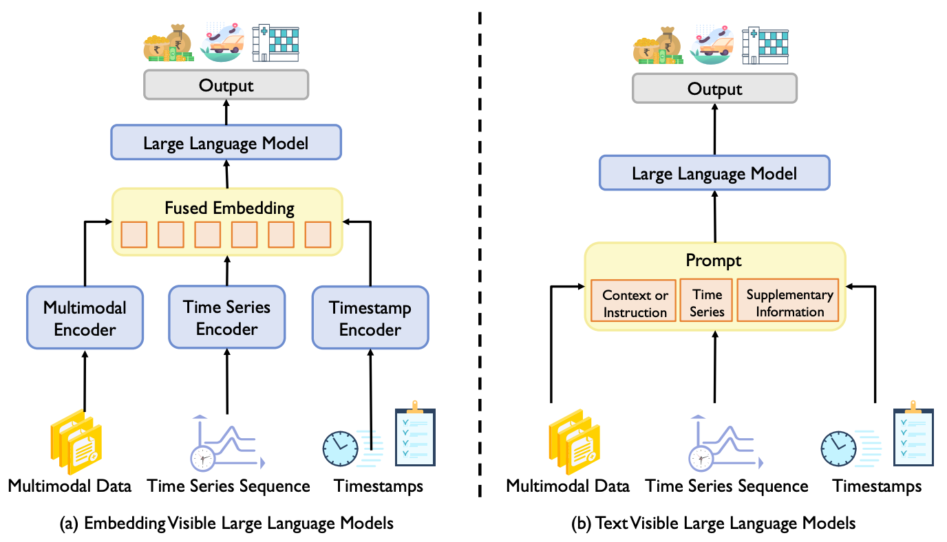
Adaptation Paradigms
Embedding-Visible: Vectorized time series inputs.
Temporal Decomposition
Multivariate Patching
Semantic Alignment
Fine-tuning strategies
Text-Visible: Time series converted into natural language prompts.
PromptCast and LLMF
LLM-Mob, TWSN
Timestamp, Cross-Sequence and Domain-specific context.

Slide 10
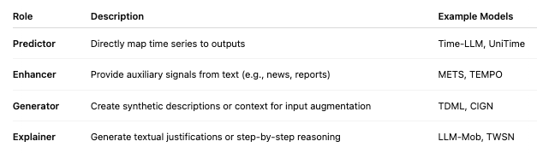
Roles of LLMs in Time Series
Adapting LLMs for time series is a promising path, but it requires modality alignment, task-specific prompting, and careful architectural design
Applications:
Forecasting
Classification
Anomaly detection
Imputation

Slide 11
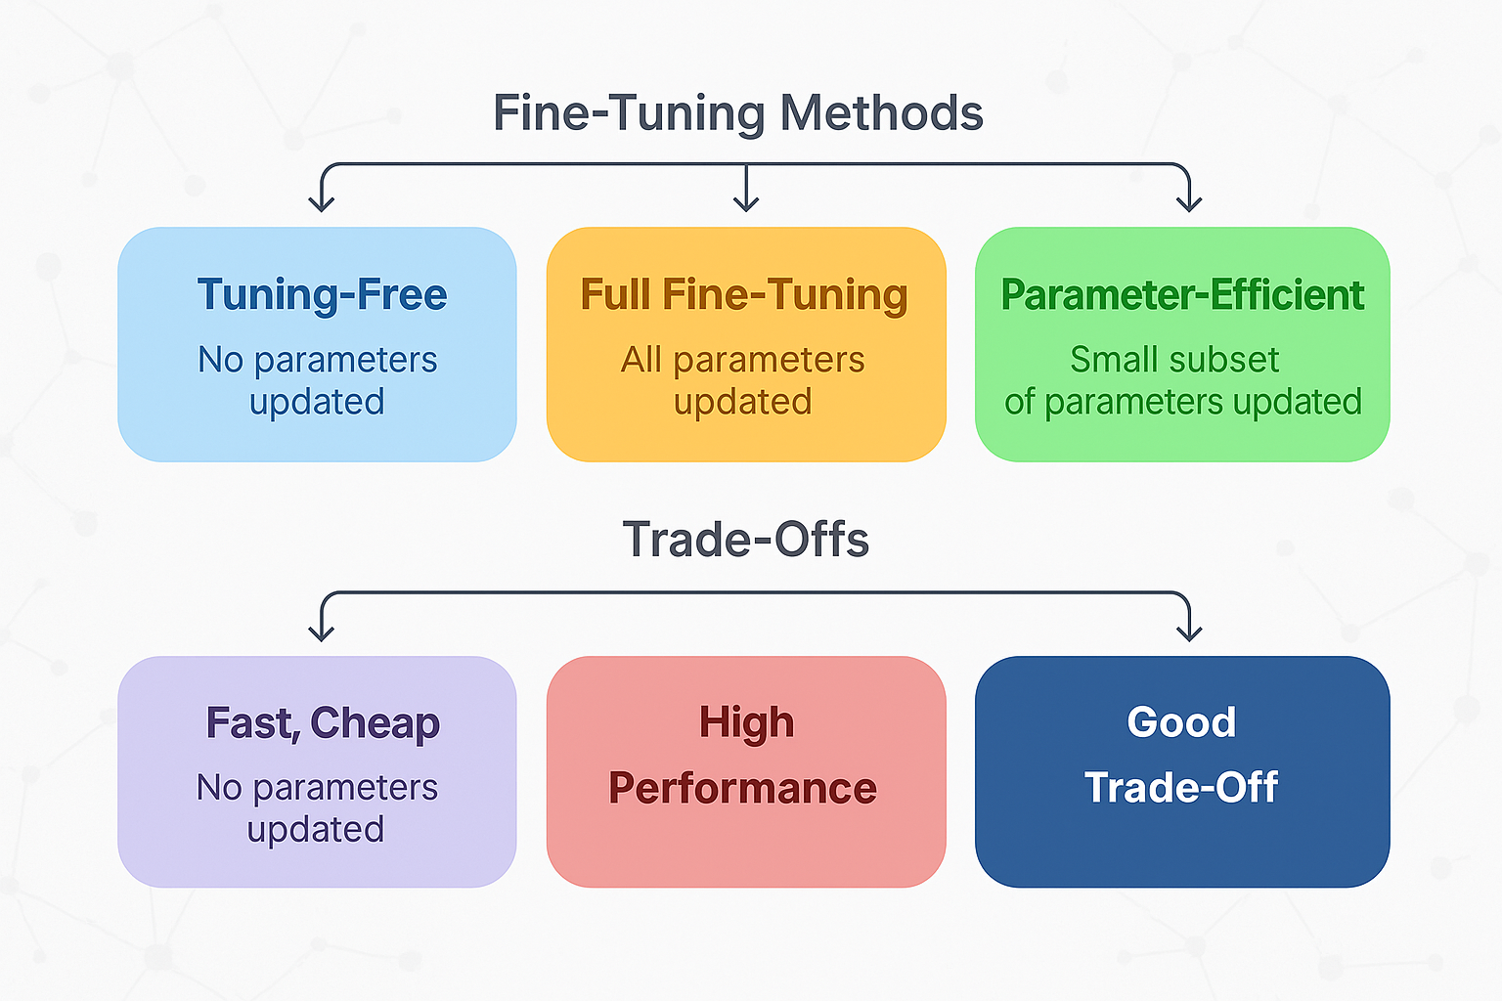
Improving Time Series Models Efficiency
Fine-Tuning Strategies:
Tuning-Free Prompting: No parameter updates.
Full Fine-Tuning: All model layers retrained.
LoRA and prompt tuning offer promising results with lower costs
Parameter-Efficient Fine-Tuning (PEFT): Selective parameter updates (e.g., LoRA, adapters).
Adapters
Prompt Tuning
Prefix Tuning
LoRA

Slide 12
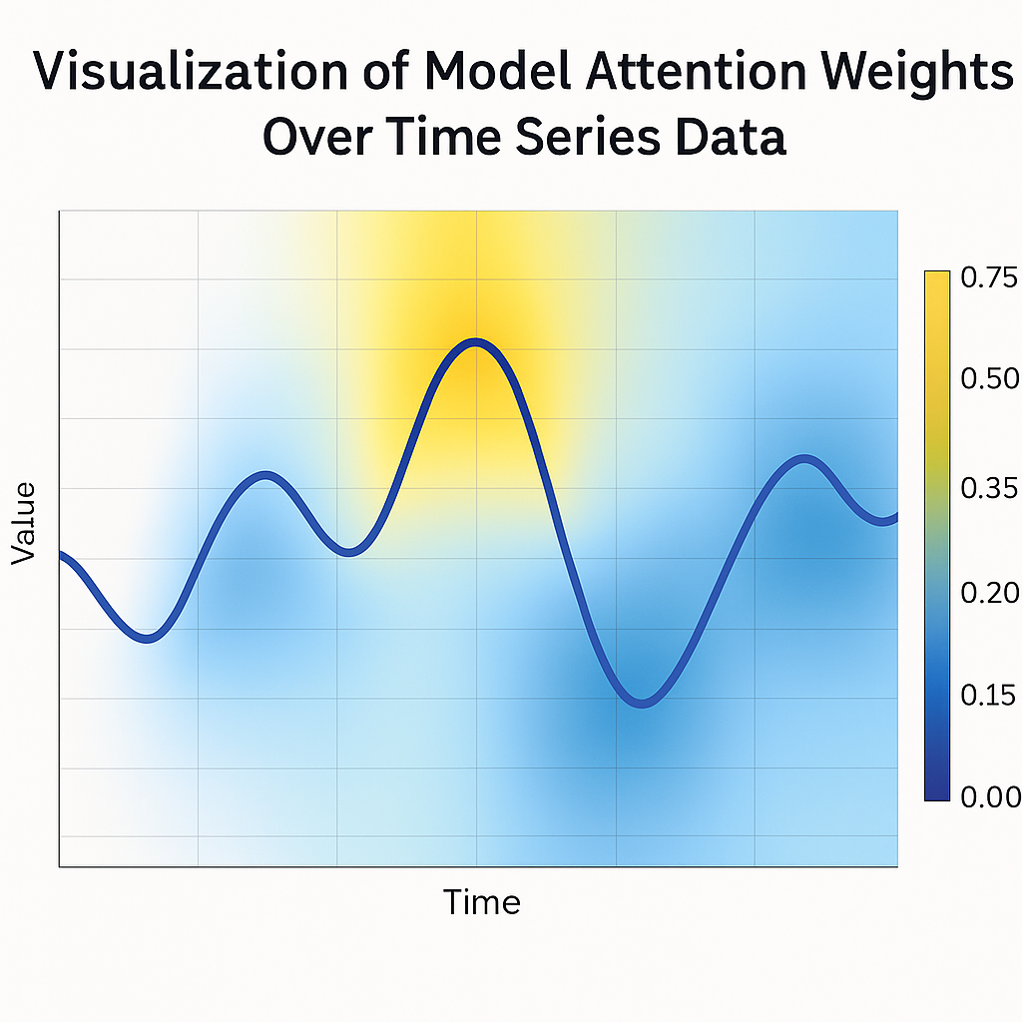
Making Foundation Models Explainable
Explanation Types:
Global Explanations: Overall model behavior.
Local Explanations: Specific prediction justifications.
Techniques:
Chain-of-Thought prompting.
Attention visualization.

Slide 13
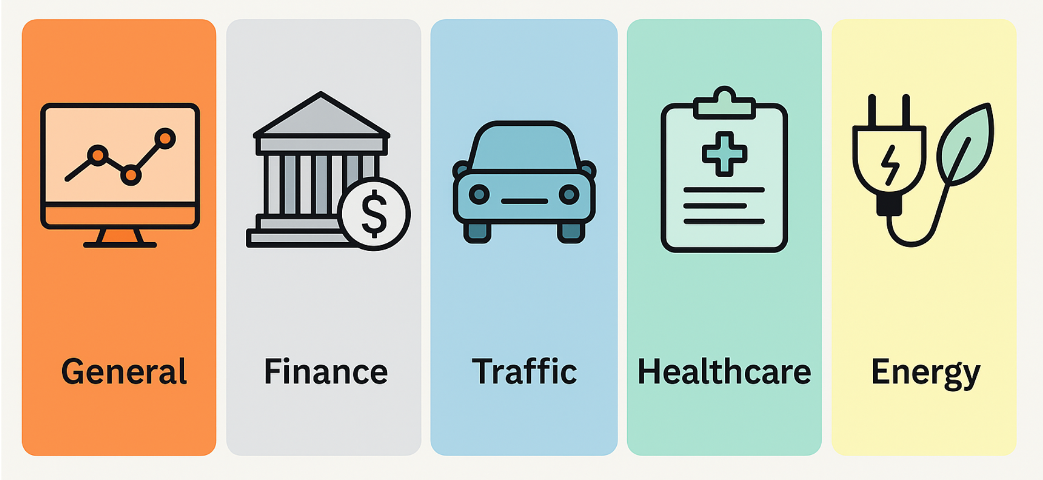
Foundation Models Across Domains
Foundation Models in Real-World Domains:
Finance: Stock prediction using financial news.
Traffic: Mobility forecasting and anomaly detection.
Healthcare: ECG signal analysis guided by medical reports.
Energy: Consumption forecasting with descriptive prompts.

Slide 14
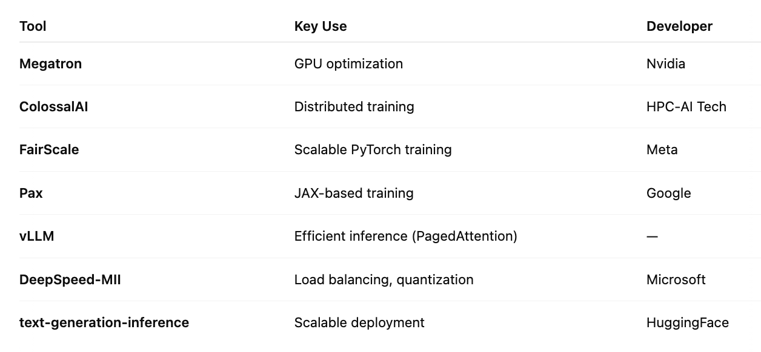
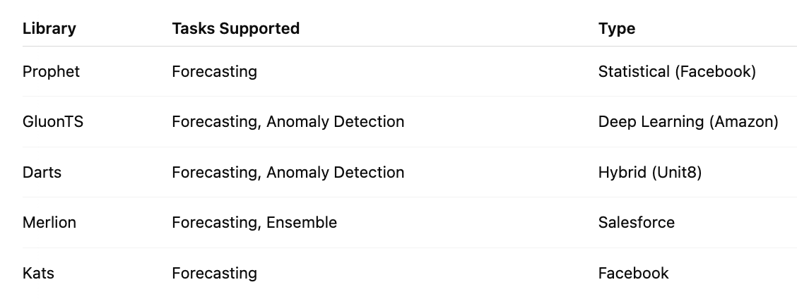
Resources
Datasets: NASDAQ-100, PTB-XL, ETT, etc.
Libraries: Darts, Prophet, Merlion, Time series analysis tools.
Frameworks: LLM deployment platforms, Megatron, Hugging Face, DeepSpeed-MII
These tools and datasets are essential to reproduce or extend the work.

Slide 15
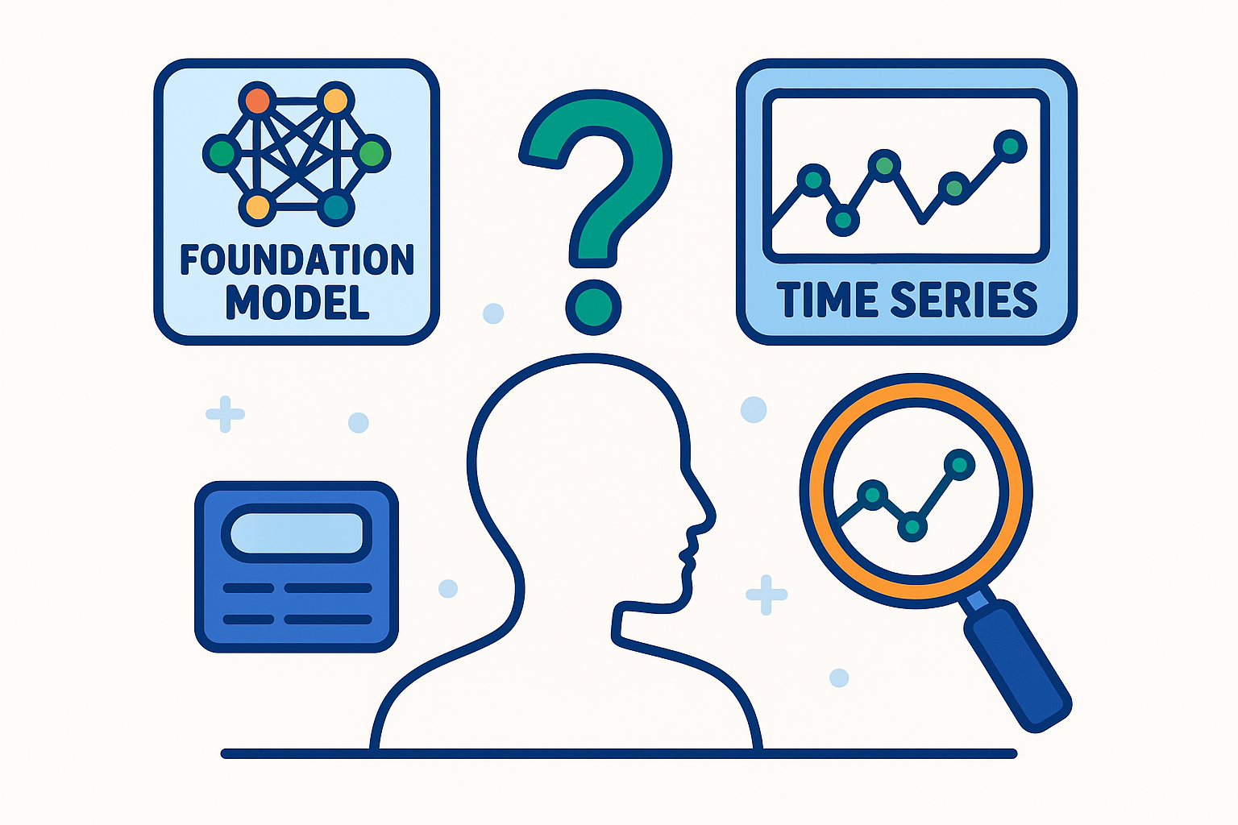
Limitations and Research Gap
Lack of ImageNet-scale datasets for time series
Poor alignment between time series and LLMs
Limited explainability in embedding-visible setups
Weak cross-domain generalization
No standardized multi-task benchmark
Underexplored multimodal combinations
Evaluation metrics often lack depth
Reproducibility issues due to closed-source models

Slide 16
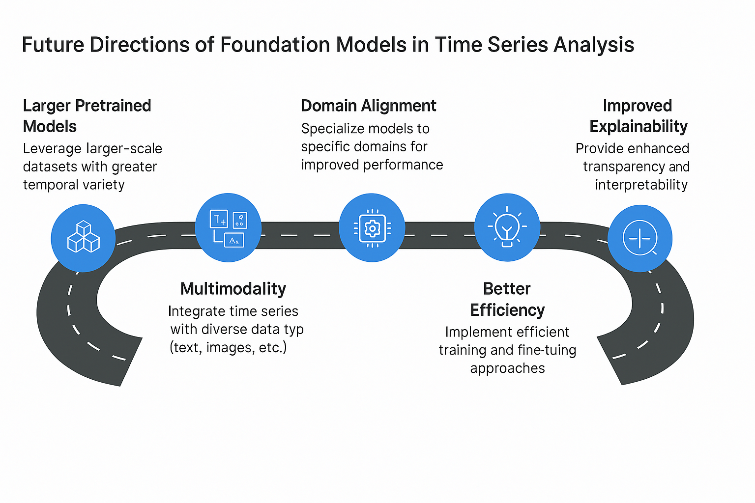
Conclusion
Summary:
Foundation models are transforming time series analysis.
The 3E framework provides a comprehensive evaluation approach.
Real-world applications demonstrate the versatility of these models.
Future Outlook:
Bridging the modality gap between time series and language.
Developing unified, flexible, and interpretable solutions.
“Foundation models may become the general-purpose engines of time-based intelligence.”

Slide 17
Thank You..!
Paper: https://arxiv.org/pdf/2405.02358
Medium Article: https://medium.com/p/3d85ce6469b7/edit
References: https://github.com/start2020/Awesome-TimeSeries-LLM-FM
Soumya Bharathi Vetukuri
016668964

